Slide 1
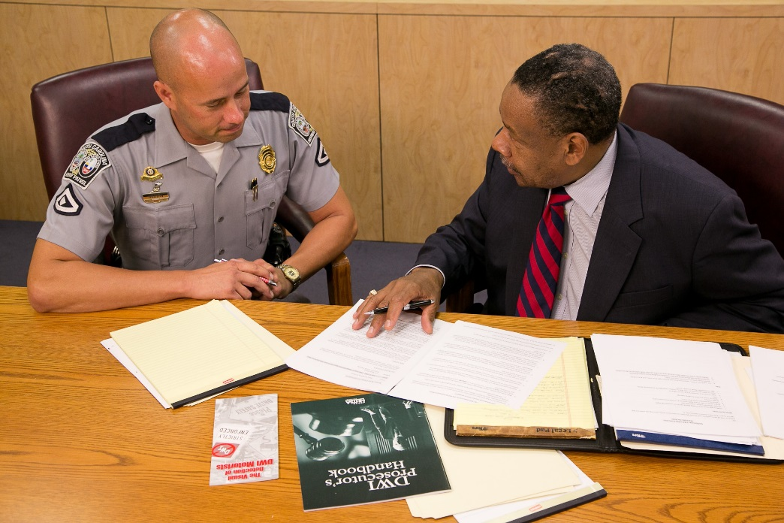



Session 8
Pre and Post
Arrest Procedures

Slide 2
Learning Objectives
Describe the Three Phases of DUI Detection Process
Describe effective roadside interview techniques
List elements of Driving Under the Influence of Drugs
Identify indicators of impairment during three phases of detection process

Slide 3
Learning Objectives
Accurately document, in sequence, observed impairment in each of the three phases of the detection process
Identify additional resources to support prosecution
Articulate relevant evidence as it relates to case preparation and prosecution

Slide 4
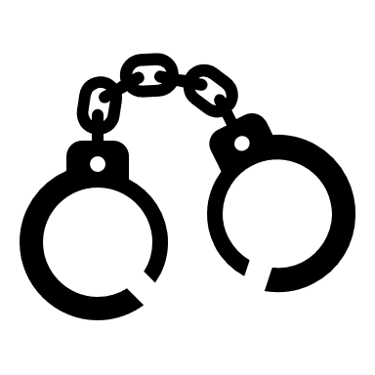
DUI Detection
Entire process of identifying and gathering evidence to determine if a subject should be arrested for a DUI violation. (Totality of the Circumstances)
This includes Reasonable Suspicion or Probable Cause for the stop.

Slide 5
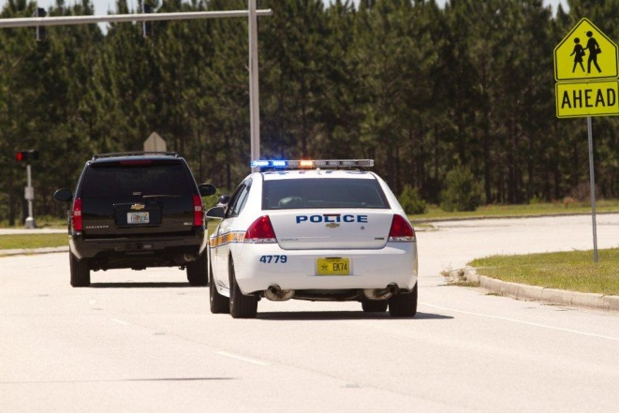
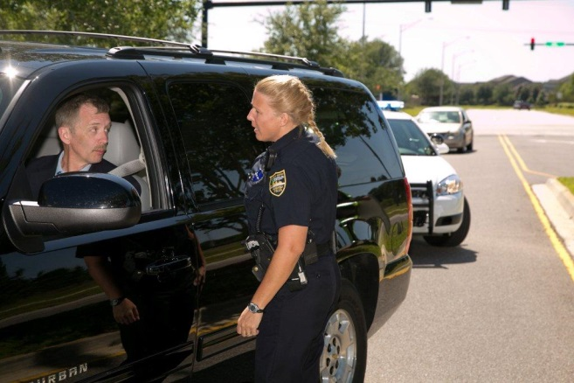
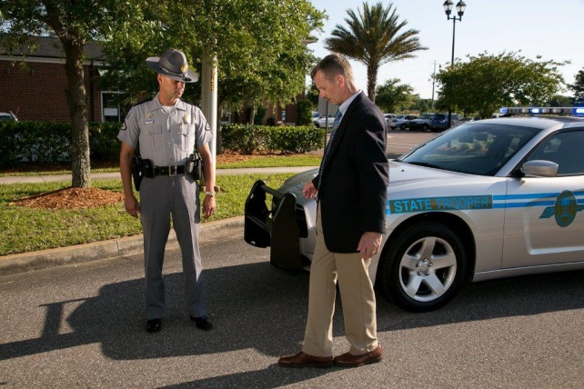
Three Phases
Pre-Arrest Screening
Vehicle in Motion
Personal Contact

Slide 6
Phase One

Slide 7
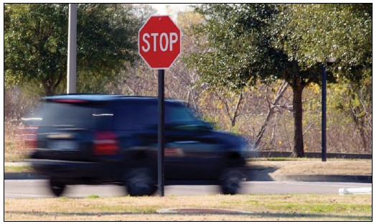
Phase One: Vehicle in Motion
What do you observe?
What do you do?
When might Phase One not occur?

Slide 8
Seizure
State v. Pulley, 863 S.W.2d 29
(Tenn. 1993)
The defendant was seized when the officer activated his blue lights
Objective test
Officer must have reasonable suspicion or probable cause to initiate blue lights
Exceptions are rare (911, Community Caretaking)

Slide 9
Reasonable Suspicion
State v. Smith, 484 S.W.3D 393 (Tenn. Crim. App. 2016)
Ms. Smith once crossed and twice touched the fog line (With both right tires)
Followed for 2 more miles without any further infractions
TCA 55-8-123 Failure to Maintain Lane
Officer must articulate specific facts for the stop (Lane departure was impracticable or without safety of move first ascertained)

Slide 10
Probable Cause
State v. Davis, Jr., 484 S.W.3d 138 (Tenn. Crim. App. 2016)
Crossed the double yellow line (With both left tires)
TCA 55-8-115 Driving on the Right Side of the Roadway
Observation of an actual traffic violation creates probable cause to seize

Slide 11
911 Call
State v. Kendall Allison Clark
2020 Tenn. Crim. App. LEXIS 273
Information provided by a known citizen informant in 911 calls was sufficient to establish reasonable suspicion to initiate the traffic stop by a responding police officer who observed the truck minutes later
Said was driver was dead or passed out (Later driving reckless)
Also permitted by the community caretaking doctrine

Slide 12
Known Citizen Tip-RS
State v. Fallon Jenkins Moore, No. E2019-01270-CCA-R3-CD, 2020 Tenn. Crim. App. LEXIS 574 (Tenn. Crim. App., Aug. 25, 2020).
Informant was a known, citizen informant and the information could be presumed reliable
The officer corroborated the information provided by the tip, within one minute of receiving the information about the possibility of a female DUI driver
Vehicle was parked at a gate of a closed church

Slide 13
Anonymous Tip - RS
State v. Hanning, 296 S.W.3d 44 (Tenn. 2009).
The anonymous tip reporting reckless driving indicated a sufficiently high risk of imminent injury or death to members of the public;
The offense was reported at or near the time of its occurrence;
The report indicated that the caller was witnessing an ongoing offense;
The report provided a detailed description of the truck, its direction of travel and location; and
The investigating officer verified those details within moments of the dispatch reporting the tip.
Notes:
This appeal involves the detention and questioning of the driver of a truck tractor and trailer based upon an anonymous tip of reckless driving from a citizen. A police officer received a dispatch that a caller had reported a black "18-wheeler" bearing a "Smith Brothers" logo was being driven recklessly in a northbound direction on the interstate and had just exited at the Highway 72 ramp. The police officer was in a parking lot very close to the exit ramp [**2] at the time he received the call. He responded immediately and observed a black "semi-truck" parked in the emergency lane of the northbound exit ramp. The officer turned his blue lights on, drove down the ramp, and pulled in front of the truck. After observing a Smith Transport logo on the door of the truck tractor, questioning the driver, and administering field sobriety tests, the officer arrested the driver for driving under the influence. The driver entered a conditional guilty plea to driving under the influence and reserved the certified question of whether the warrantless detention and questioning of the driver violated the Fourth Amendment to the United States Constitution and Article I, Section 7 of the Constitution of the State of Tennessee. We hold that in this case the anonymous tip reporting reckless driving indicated a sufficiently high risk of imminent injury or death to members of the public to warrant immediate intervention by law enforcement officials and justified the brief investigatory stop because the offense was reported at or near the time of its occurrence, and the report indicated that the caller was witnessing an ongoing offense; the report provided a detailed [**3] description of the truck, its direction of travel and location; and the investigating officer verified these details within moments of the dispatch reporting the tip.

Slide 14
Community Caretaking
State v. McCormick, 494 S.W.3d 673 (Tenn. 2016)
1) The nature and Level of Distress exhibited by the citizen;
2) The location;
3) The time;
4) The accessibility and availability of other assistance; and
5) The risk of danger if the officer provides no assistance.

Slide 15
McCormick Facts
Tahoe blocking 75% of the driveway to a closed grocery store
Tahoe was partially in the roadway
Sgt. Daniel Trivette pulled in behind vehicle
Activated rear lights to keep from getting hit from behind
Went to check on driver
Engine on, loud music, driver slumped over
Tried to wake for 1 minute
Opened door, found a passed out inebriated driver

Slide 16
Sobriety Checkpoints
State v. Downey, 945 S.W.2d 102 (Tenn. 1997).
The use of a sobriety roadblock, although a seizure, can be a reasonable seizure under the Tennessee Constitution, provided it is established and operated in accordance with predetermined operational guidelines and supervisory authority that minimize the risk of arbitrary intrusion on individuals and limit the discretion of law enforcement officers at the scene.

Slide 17
Phase Two

Slide 18
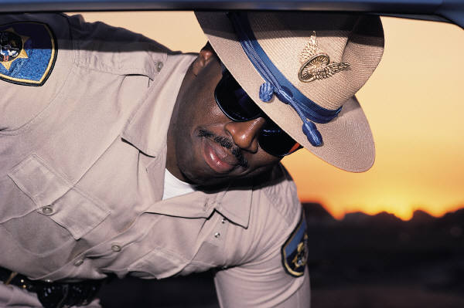
Phase Two: Personal Contact
What do you observe?
What do you do?
When might Phase Two not occur?

Slide 19
Totality Of The Circumstances
What do you See, Hear and Smell?
How are they acting?
Is paraphernalia present?
Do they know where they are? Going to/from?
Do they know the time?
Are they ill? Prescribed anything? Taking anything?
Document everything! If it is part of your Probable Cause, then document it!

Slide 20
Phase Three

Slide 21
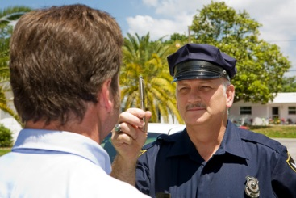
Phase Three: Pre-Arrest Screening
Administer SFSTs and additional ARIDE tests
Preliminary breath test

Slide 22
Each Detection Phase
Two major tasks
Each task has one major decision
Each decision has any one of three outcomes:
  Yes – Do it Now
  Wait – Look for Additional Evidence
  No – Don’t Do It

Slide 23
Effective Roadside
Interview Techniques
This evidence is critical to successful prosecution of the DUI case
Necessary to gather valuable information during detection
Learn and practice effective roadside interview techniques

Slide 24
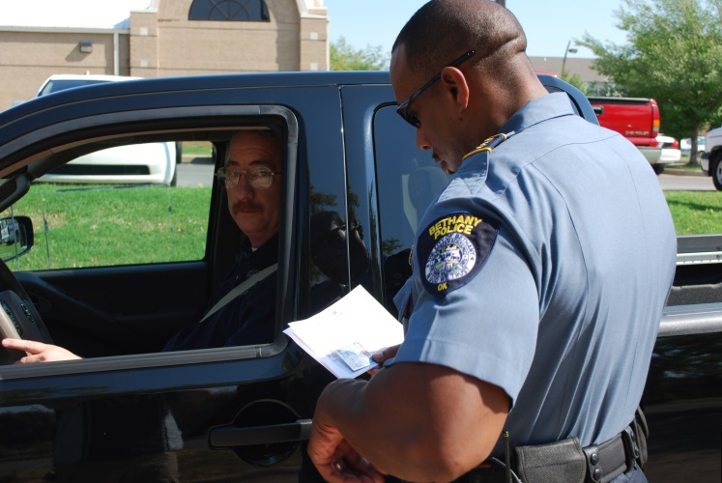
What You Say
Word choice
Communication style
Tailor questioning speed and tone to the situation and circumstances

Slide 25
What You Do
Physical positioning, demeanor
Goal: encourage cooperation
Facilitate open dialog
Develop a good rapport with the subject

Slide 26
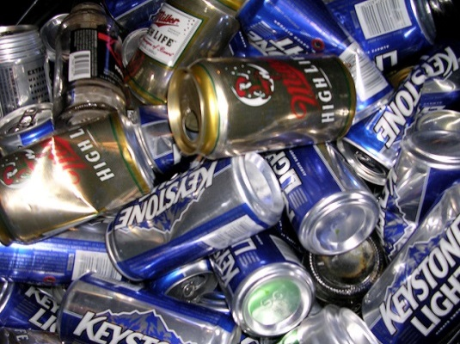
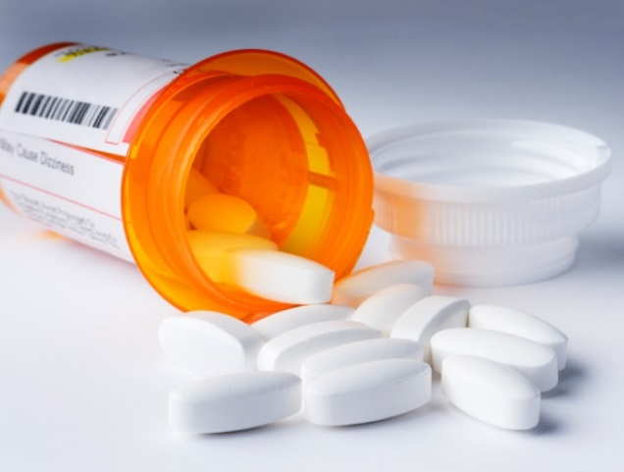
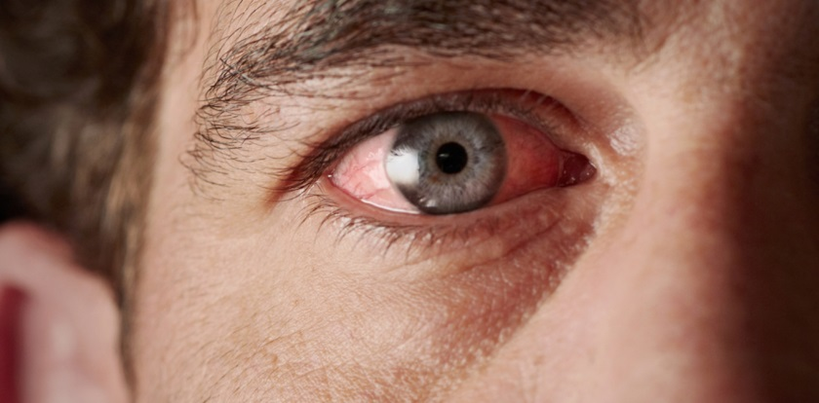
What You See, Smell, Hear

Slide 27


Identifying and Documenting
Detection begins with observation of the vehicle:
Document in order of the 3 Phases
Document environmental and other conditions

Slide 28

If you didn’t write it down,
It didn’t happen

Slide 29
DUI LAW
TCA §55-10-401
1) Driving or in physical control of a Motor Vehicle
2) Public Roads, Shopping Centers, Trailor Park, Apt. Complex, OR other premises generally frequented by the public
3) While under the Influence of any Impairing Substance
Any intoxicant or drug that impairs the driver’s ability to safely operate a motor vehicle by depriving the driver of the clearness of mind and control of oneself that the driver would otherwise possess (Mental or Physical Impairment)
OR
4) Per Se Laws .08 (.04 for CMV drivers)

Slide 30
DUI CASE LAW
Physical Control
State v. Butler, 108 S.W.3d 845 (Tenn. 2003).
Butler was in physical control while 100 yards from his motorcycle. Spark plug and key in his pocket.
He admitted driving to the parking lot.
Combination of physical control and circumstantial evidence was sufficient.
Circumstantial evidence of driving on a public road.

Slide 31
Totality of Circumstances
Probable Cause
State v Bell, 429 S.W.3d 524 (Tenn. 2014)
The supreme court held that the officer had probable cause to arrest the defendant for DUI without a warrant. Performance on field sobriety tests is only one, of the many factors, officers should consider when deciding whether to arrest a motorist for DUI or similar offenses without a warrant.
Mr. Bell did well on the SFSTs, but he exhibited bad driving, smelled of alcohol and admitted to drinking alcohol.
His BAC was .15%

Slide 32
Birchfield v. North Dakota
136 S.Ct. 2160 (2016)
Breath test can be required as a search incident to a lawful arrest even if no consent (of course you still need their cooperation)
Get a search warrant for blood, unless the Defendant consents or you must be prepared to articulate exigent circumstances.

Slide 33
Preference for Search Warrant
Missouri v McNeely, 133 S.Ct. 1552 (2013)
U.S. Supreme Court rules that search warrants are mandatory for blood draw, unless consent or exigent circumstances exist.

Slide 34
Exigent Circumstances Exception to SW Preference
“Totality of the circumstances”
State v. Martin, No. M2016-00615-CCA-R3-CD, 2017 Tenn.Crim.App. LEXIS 365 (May 11, 2017)
State v. Oaks, No. E2017-02239-CCA-R3-CD, 2019 Tenn.Crim.App. LEXIS 93 (February 12, 2019)
When was Probable Cause formed?
Was any other Officer available to start the SW process?
What other pressing needs were present?

Slide 35
Exigent Circumstances Exception to SW Preference
Mitchell v. Wisconsin,139 S.Ct. 2525, 204 L.Ed.2d 1040 (2019)
Schmerber v. California’s “other pressing duties” is still valid for E/C
A “compelling need for official action” will allow no time for a search warrant
Unconsciousness, medical emergencies and crashes = exigent circumstances (Almost always the general rule)
Supreme Ct. recognized an “exigency spectrum” (From average DUI to crash/medical emergency)
“It would be perverse if the more wanton behavior were rewarded—if the more harrowing threat were harder to punish”

Slide 36
Voluntary Consent Exception to SW Preference
State v. Pamela Kidd Hafer,
2020 Tenn. Crim. App. LEXIS 143
Consent before the reading of an unconstitutional implied consent form containing criminal sanctions, and subsequent second consent was voluntary where there was no evidence that the defendant’s will was overborn or that her capacity for self-determination was critically impaired
Consent MUST BE both knowing and voluntary

Slide 37
Exclusionary Rule: Good Faith Exception in State v. Reynolds,
504 S.W.3d 283 (Tenn. 2016)
There is a limited Good Faith exception to the exclusionary rule
The officer must be in strict compliance with binding precedent and agency policy at the time of the search
(also, consent was not sufficient in this case due to disability, crash injuries and medication)

Slide 38
Other Lawful Means
State v. Moore, No. M2020-01147-CCA-R3-CD, 2022 Tenn. Crim. App. LEXIS 164 (Tenn. Crim. App., Apr. 12, 2022)
The results of a blood draw used by the hospital for medical treatment were admissible.
(Get a search warrant for the hospital blood sample and a subpoena for the medical records)
Notes:
One week after the wreck, Sergeant Bellavia sought and obtained a judicial subpoena for Defendant's medical records. The medical records included a blood draw which showed that Defendant's blood alcohol content was .176 on the night of the crash.
Ebony Harris, a phlebotomist, testified that she worked at Skyline Medical and drew the blood sample from Defendant on the night of the incident. She received instructions to draw blood while Defendant was in the emergency room. Before the blood draw, Ms. Harris ensured Defendant's identity by matching her armband with the labels generated by the computer system. There was a slight mistake in Defendant's identifying information, listing her as a 36-year-old female instead of a 26-year-old female. During a blood draw, the phlebotomist writes her initials and the time on the tubes. Demographic labels are attached to the tubes containing the patient's name, account number, and birthdate. The tubes are sealed in a biohazard bag. The samples can be delivered to the lab in three different ways: by the phlebotomist on foot, by a lab tech retrieving them from the emergency room, or by the hospital's tube system using codes. Ms. Harris did not recall the delivery method used for the samples in this case.
When the person performing the testing receives the bag, he or she enters the time into the computer and determines which lab department is in charge of testing. The results are automatically entered into the system. In Defendant's case, orders for specific blood tests were given after the blood draw at 9:20 p.m.
The trial court ultimately denied the motion to suppress, finding that the blood draw was performed by the hospital without state action and that the State did not unreasonably delay seeking an indictment.

Slide 39
Case Preparation
Know your Legal Requirements
Develop Case File
Don’t skip steps
Know your limitations
Ask for help

Slide 40
During the Detection Process
Keep in mind your State legal requirements
Organize and document observations in terms of the three detection phases
Successful prosecution for impaired driving begins with building a DUI prosecution team

Slide 41
Prosecution Team

Slide 42
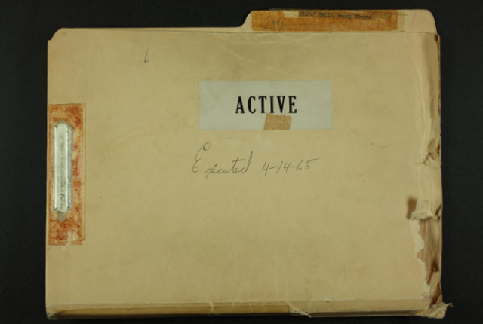

What is in a Case File?
Remember
Comprehensive Case Preparation Yields Effective Courtroom Presentation

Slide 43
What is in a Case File?
All Observations
All Evidence
Potential Witness List
Chemical Test Results
Photos, Diagrams, Scene Sketch
Other?

Slide 44
Phase One:
Who Can Help?
Officer who observed driving and/or made traffic stop
Other officers
Lay witnesses (Get their contact information and written statements)

Slide 45
Phase Two:
Document Observations
Note every observation made regarding personal contact (including paraphernalia)
Include observations before and after subject exits vehicle
Documenting can reinforce reasonable suspicion for the stop

Slide 46
Phase Three:
Thoroughly Document
HGN, WAT, OLS and other sobriety tests, including associated clues
Potential team members:
  Law enforcement officer(s)
  Lay witnesses

Slide 47
Post Arrest Process
Potential Team Members
Breath testing operators/technical supervisors
DREs
Medical personnel
Jail personnel

Slide 48
Pre-Trial Preparation
Who Can Help?
Local Prosecutor
Toxicologist
DRE/DRE State Coordinator
TSRPs
IACP DEC Program Coordinator
NHTSA/NAPC Prosecutor Fellow
NTLC

Slide 49
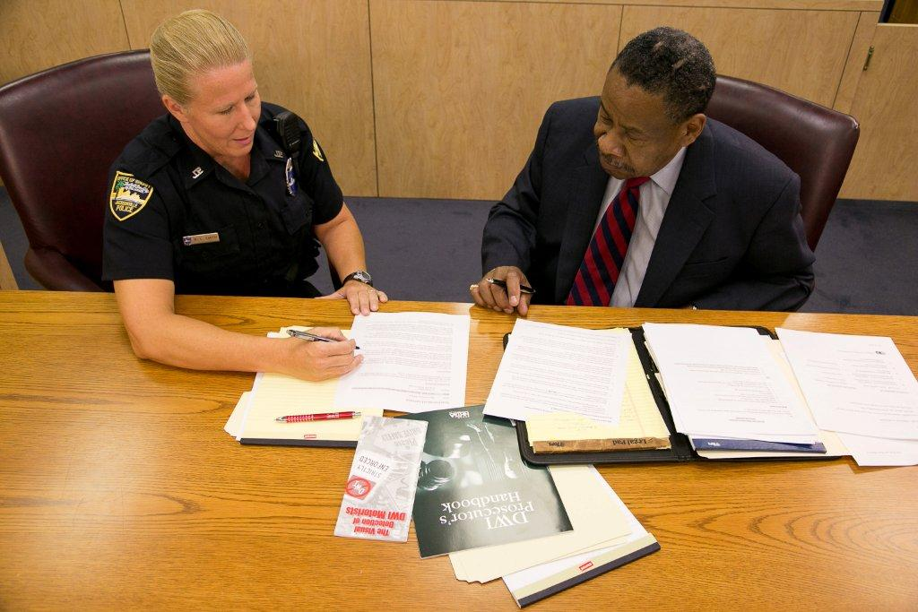
Pre-Trial
Review your case file
Meet with prosecutor
Anticipate defense
Develop visual aids
Other

Slide 50
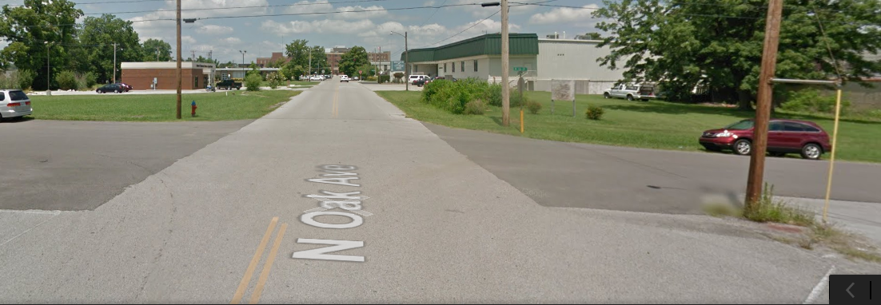
Visual Aids
Pictures (Paraphernalia, Soiled clothing, Etc.)
Location of Stop (Accident reconstruction)
Appearance of the Defendant (Booking photo)
Video - Performance on SFSTs
Charts or Diagrams
Officer’s Training and Experience (CV)
Elements

Slide 51
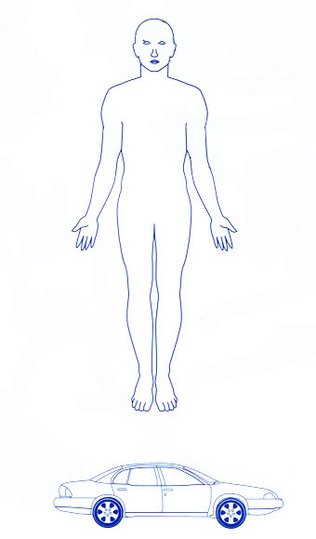
Use this chart to list all signs of impairment!
It will put the emphasis back onto the defendant’s criminal conduct and it’s a very effective exhibit for the jury

Slide 52
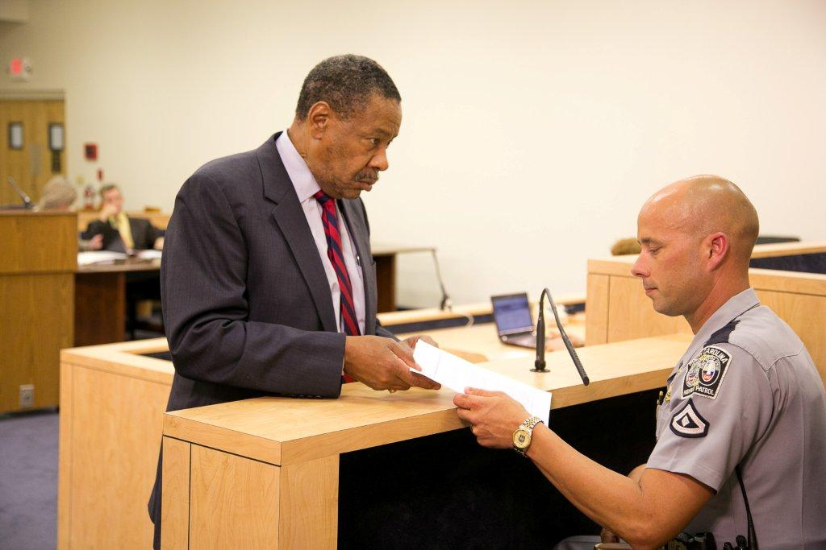
Trial

Slide 53
Trial
Direct Examination
  Use Visual Aids
  Use Plain English
  Listen Carefully to the Question
  Think Before You Answer
  Ask for Clarity if Needed
  Relate Training and Experience
  Talk to Your Audience

Slide 54
Trial
Cross Examination
  Be Professional (Not argumentative or smart responses)
  Answer only the Question Asked
  If You Don’t Know the Answer, Just Say So
    I do not know
    I do not recall
    I cannot answer that question without explanation

Slide 55
Trial
Cross Examination
Three types of Questions:
1). Concessions
2). Impeachment
3). Competency Attack

Slide 56
Trial
Cross Examination
Golden Rules:
1). Always tell the Truth
2). Admit Mistakes
3). Don’t Guess
4). Listen Carefully to the Question
5). Yes or No, then “May I Explain?”
6). Be Professional and Never Argue!

Slide 57

Are you prepared?
There are no Shortcuts!

Slide 58
Questions?

